Slide 1

A PRESENTATION ON
Factors Influencing the Choice for Electric Vehicles in Bangladesh: A Study of Market Penetration and Consumer Preferences
Presented by
S.M. Abdullah Al Jobair Raihan
ID: 1904145
Under the Supervision of
Dr. Moazzem Hossain
Professor, Department of Civil Engineering, BUET

Slide 2
BACKGROUND AND MOTIVATION
Road transport alone accounts for approximately 25% of fossil fuel related CO₂ emissions worldwide.
Urgent need for a cleaner alternative
Developed countries like China, Norway, and Germany have boosted EV adoption through tax incentives, subsidies, and strict emissions regulations.
Bangladesh government has set an ambitious goal of achieving 30% EV adoption by 2030
2

Slide 3
01
02
RESEARCH OBJECTIVES
To provide a comprehensive overview of electric vehicle (EV) adoption in Bangladesh by examining market penetration, pricing, tax policies, and charging infrastructure.
To identify the barriers regarding EV adoption in Bangladesh
To determine the factors that influence the choice between EV and ICE vehicles
03
3

Slide 4


SCOPE OF STUDY
Private Passenger Cars
Two Wheelers
Three Wheelers
Freight Transportation Related Vehicles
4

Slide 5



EV ADOPTION SCENARIO WORLDWIDE
Adoption of electric vehicles (EVs) notably increased between 2003 to 2011 due to better awareness and acceptance of new technology among consumers.
Leading the electric vehicle (EV) sales worldwide
Similar EV adoption goal to Bangladesh, 2% market penetration upto 2024
5

Slide 6
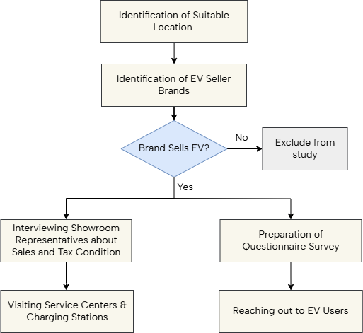
METHODOLOGY
6

Slide 7





EV SELLING BRANDS IN BANGLADESH
Audi
BMW
MG
Mercedes-Benz
BYD
7

Slide 8
EV MARKET IN BANGLADESH
8

Slide 9
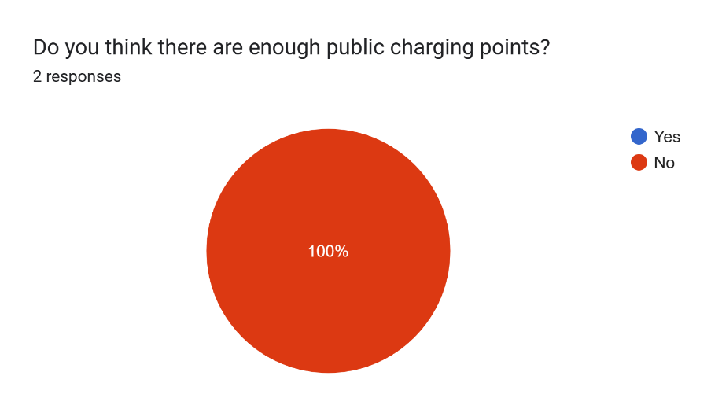

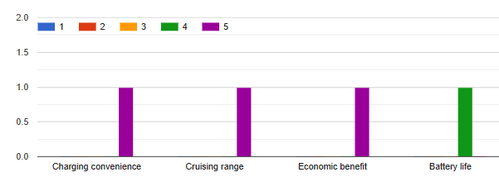
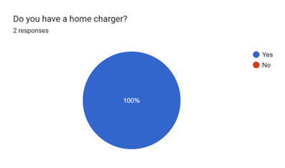
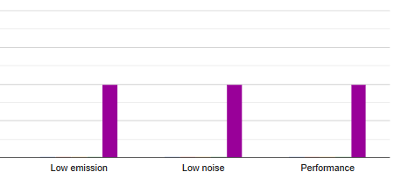
EV USERS SURVEY RESULTS
9

Slide 10
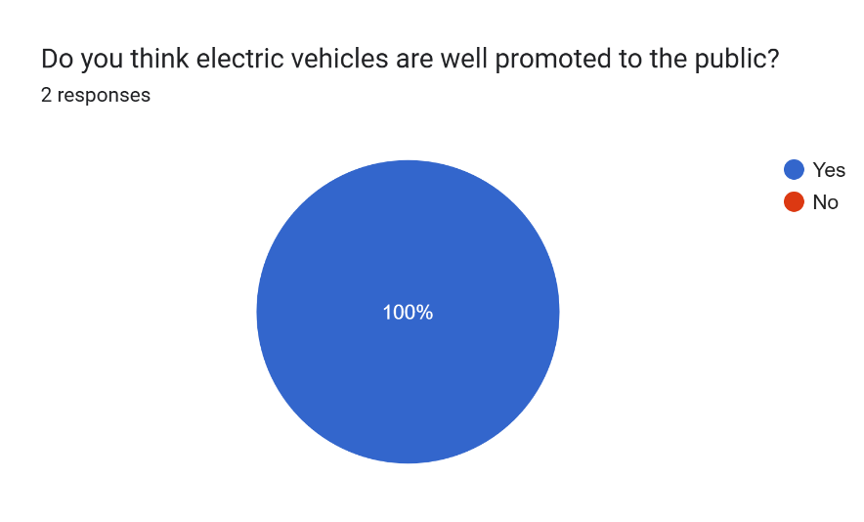
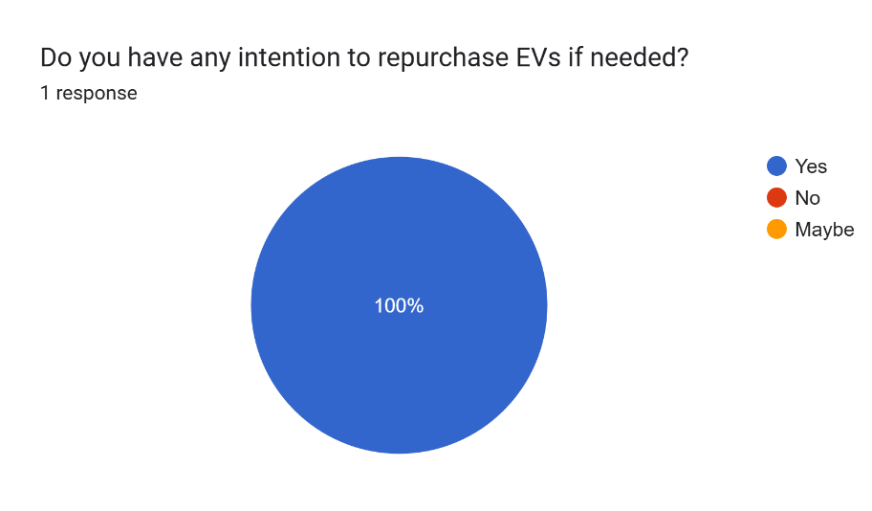
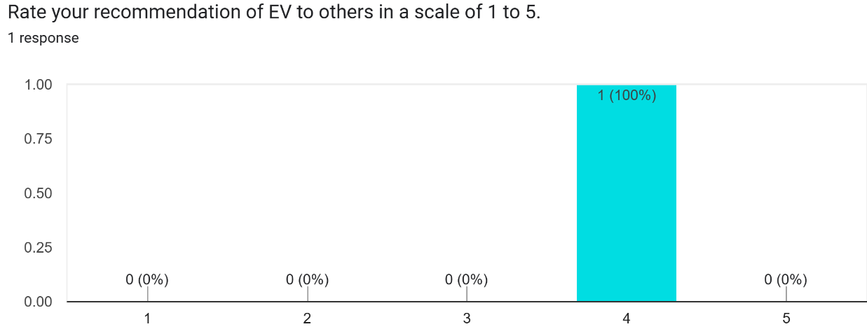
EV USER SURVEY RESULTS
10

Slide 11
ISSUES RELATED TO EV ADOPTION
High Purchase Cost
Limited Availability of EV Models
High Import Duty
Insufficient Public Charging Infrastructure
Lack of Service Centers
Insufficient Public Charging Infrastructure
Lack of Public Awareness
11

Slide 12
METHODOLOGY
Identification of Factors Influencing Consumer Preference
Preparation of Questionnaire Survey
Development of Binomial Logit Model
Model Calibration and Validation
12

Slide 13
STATED PREFERENCE SURVEY
Table: Factors that Might Influence the Choice between EV and ICE
Socio-economic Variables | Vehicle Attributes (Using a 1 to 5 scale) | Behavioral and Perception Variables (Using a 1 to 5 scale)
Age Gender Income No. of people in family Educational Qualification Occupation Vehicle owned or not | Purchase Cost Operating Cost Maintenance Cost Resale Value Driving Range Availability of charging or fueling Quick Acceleration Smooth Riding Experience Interior Space Noise Level Environmental Protection | Hearing about EV Knowledge about EV Cost awareness about EV Belief in sustainability about EV
13

Slide 14
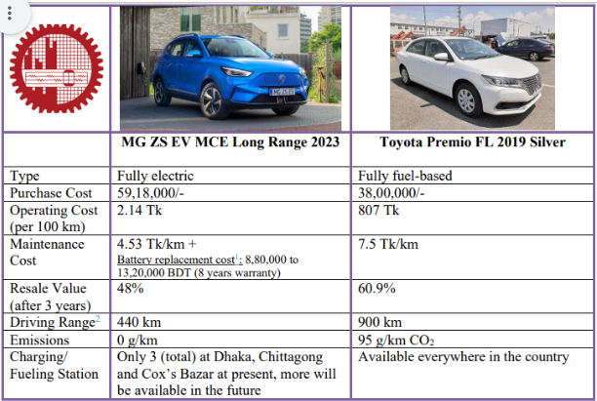
STATED PREFERENCE SURVEY
214 Tk
Figure: Showcard Used in Stated Preference Survey
14

Slide 15
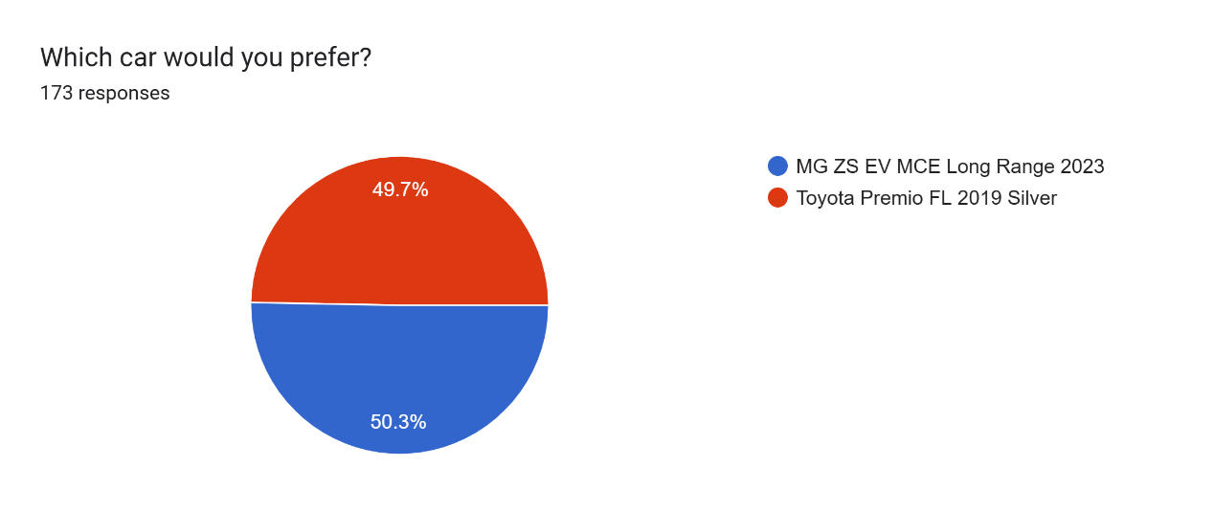
STATED PREFERENCE SURVEY
Figure: Preference Result between EV and ICE
15

Slide 16
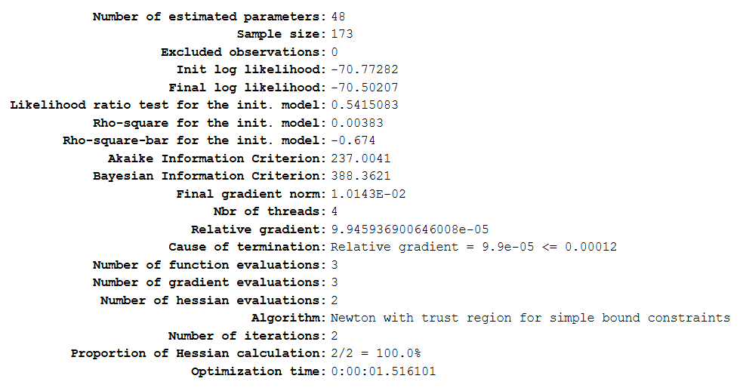
LOGIT MODEL WITH ALL VARIABLES
ρ² close to zero, very low
Figure: Estimation Report of the Logit Model Including All Variables
16

Slide 17
LOGIT MODEL WITH ALL VARIABLES
Table: Robust p-value (85% confidence interval) of Some of the Estimated Parameters of the Model Including All Variables
Parameter Name | Robust p-value | Retained?
B_AVAIL_CHAGE_FUEL_EV | 0.0132 | Yes
B_COST_AWARE_EV_EV | 0.406 | No
B_MAINTENANCE_COST_EV | 0.622 | Yes (Important parameter although p>0.15)
B_OCCUP_STU_EV | 0.115 | Yes
B_OCCUP_JOB_EV | 0.232 | Yes (Since the other dummy variable satisfies)
17

Slide 18
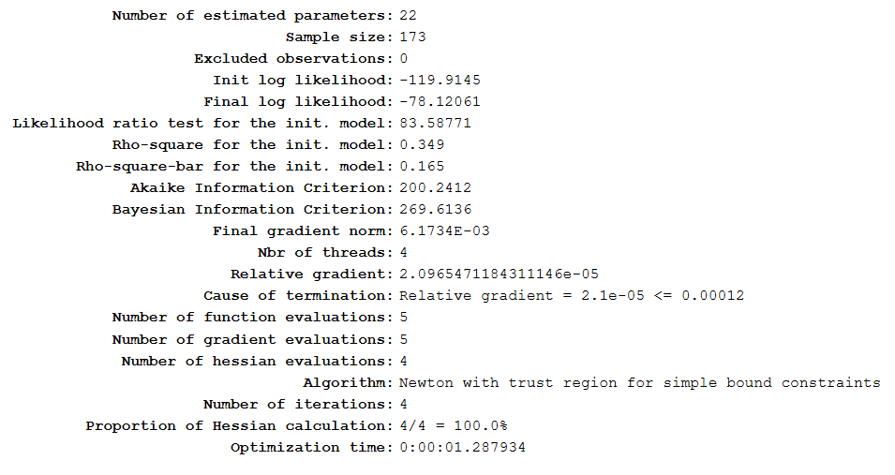
LOGIT MODEL WITH RETAINED VARIABLES
ρ² improved after removing variables
Figure: Estimation Report of the Logit Model Including Retained Variables
18

Slide 19
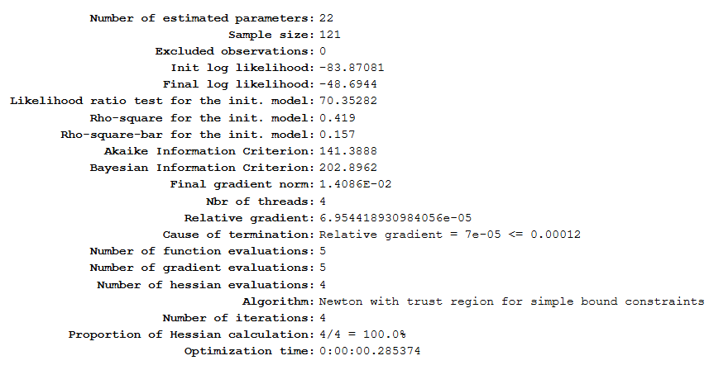
MODEL CALIBRATION
Figure: Estimation Report of the Logit Model Using Train Set (70% of Dataset)
19

Slide 20
VALUE OF PARAMETERS
Table: Value of Parameters of EV Utility Function
Name | Value | Name | Value
ASC_EV | -1.54 | B_MAINTENANCE_COST_EV | -0.0225
B_EQ_EV | -0.511 | B_RESALE_VALUE_EV | -0.162
B_OCCUP_STU_EV | 0.572 | B_AVAIL_CHAGE_FUEL_EV | -0.31
B_OCCUP_JOB_EV | 0.483 | B_ENVIRONMENTAL_PROTECTION_EV | 0.498
B_PURCHASE_COST_EV | -0.0206 | B_SUSTAIN_EV_EV | 0.261
B_OPERATING_COST_EV | 0.119
20

Slide 21
VALUE OF PARAMETERS
Table: Value of Parameters of ICE Utility Function
Name | Value | Name | Value
ASC_ICE | 1.54 | B_MAINTENANCE_COST_ICE | 0.0225
B_EQ_ICE | 0.511 | B_RESALE_VALUE_ICE | 0.162
B_OCCUP_STU_ICE | -0.572 | B_AVAIL_CHAGE_FUEL_ICE | 0.31
B_OCCUP_JOB_ICE | -0.483 | B_ENVIRONMENTAL_PROTECTION_ICE | -0.498
B_PURCHASE_COST_ICE | 0.0206 | B_SUSTAIN_EV_ICE | -0.261
B_OPERATING_COST_ICE | -0.119
21

Slide 22
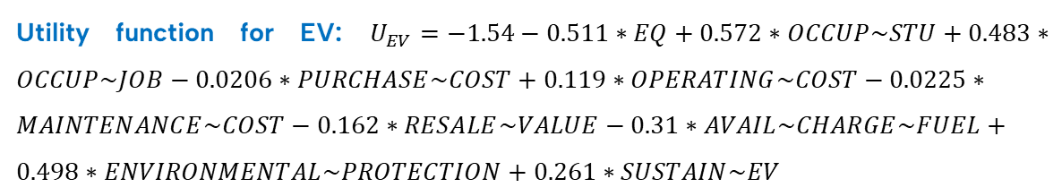
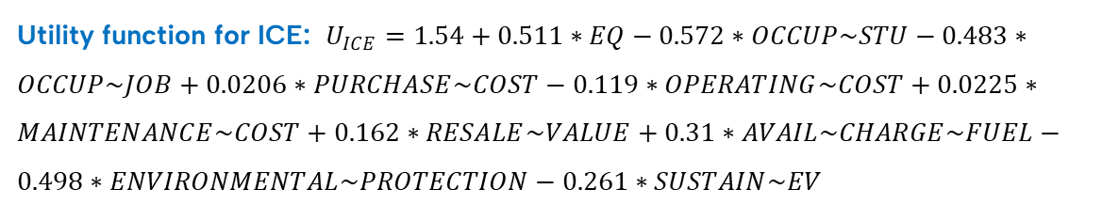
UTILITY FUNCTIONS
Utility function for EV: $U_{EV}=−1.54−0.511∗EQ+0.572∗OCCUP\sim STU+0.483∗OCCUP\sim JOB−0.0206∗PURCHASE\sim COST+0.119∗OPERATING\sim COST−0.0225∗MAINTENANCE\sim COST−0.162∗RESALE\sim VALUE−0.31∗AVAIL\sim CHARGE\sim FUEL+0.498∗ENVIRONMENTAL\sim PROTECTION+0.261∗SUSTAIN\sim EV$
Utility function for ICE: $U_{ICE}=1.54+0.511∗EQ−0.572∗OCCUP\sim STU−0.483∗OCCUP\sim JOB+0.0206∗PURCHASE\sim COST−0.119∗OPERATING\sim COST+0.0225∗MAINTENANCE\sim COST+0.162∗RESALE\sim VALUE+0.31∗AVAIL\sim CHARGE\sim FUEL−0.498∗ENVIRONMENTAL\sim PROTECTION−0.261∗SUSTAIN\sim EV$
22

Slide 23
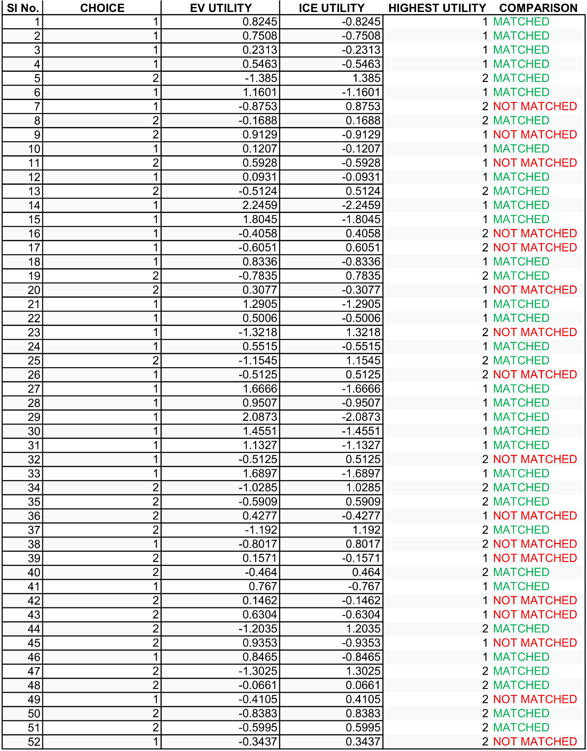
MODEL VALIDATION
Figure: Model Validation on Test Set (30% of Dataset)
23

Slide 24
LIMITATIONS & RECOMMENDATIONS
Limitations | Recommendations
Small sample size | Larger and more diverse sample
Lack of publicly available data on EV sales, charging infrastructure, and consumer demographics | Establishment of a centralized database with real-time tracking of EV registrations and charging stations
Not so much focus on HEVs and PHEVs | Investigation of consumers preferences in HEVs and PHEVs
No in-depth research about factors regarding charging convenience | Exploration of the factors regarding charging convenience
No evaluation the effectiveness of these policies in driving EV adoption | Assessment of the effectiveness of government incentives
24

Slide 25
THANK YOU. ANY QUESTIONS?

